Slide 1

Classifying Text with Tensorflow
Done by:
Basava Sanketh BN

Slide 2

Agenda
Introduction
Problem Statement
Data Collection
Exploratory Data Analysis
Data visualisation
Model Evaluation
Conclusion

Slide 3

Introduction
Text classification is the process of categorizing text into organized groups.
It is used in many applications such as sentiment analysis, document organization and topic identification.
In this project, we will use Tensorflow to create a text classification model that can accurately classify text into respective groups.
The dataset used in this project can be chosen from an online source or any inbuilt dataset of the Tensorflow library.
The goal is to create a model that can accurately classify text into the respective groups.

Slide 4

Aim and Problem Statement
Aim: The aim of the text classification project using the diabetes dataset is to develop a machine learning model that can accurately predict whether a patient has diabetes or not based on their medical history. The project involves preprocessing the dataset, exploring the data, engineering new features, selecting an appropriate machine learning algorithm, training the model, and evaluating its performance. The ultimate goal is to create a reliable and accurate diagnostic tool that can assist healthcare professionals in making informed decisions regarding the diagnosis and treatment of diabetes.
Problem Statement: The problem statement is to develop a machine learning model that can accurately classify patients as diabetic or non-diabetic based on their medical history. The goal is to improve the accuracy and efficiency of diabetes diagnosis and treatment, as early diagnosis and treatment are crucial in managing diabetes and preventing complications.

Slide 5

Data Collection
We have got dataset from the Kaggle
https://www.kaggle.com/code/gauravduttakiit/resume-screening-using-machine-learning/data
This dataset consists of 9 columns and 767 rows

Slide 6

EDA
Checking for missing and duplicates values
Done Feature engineering
Done Feature scaling (Standard Scaler)

Slide 7
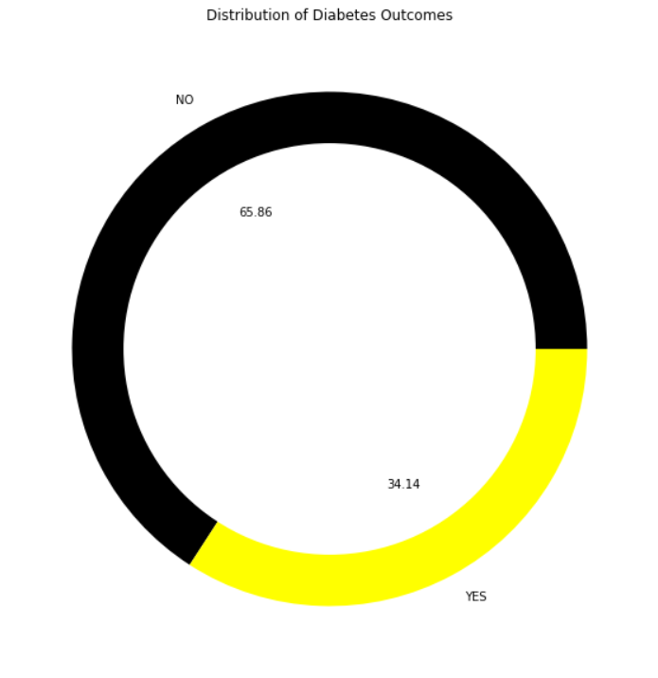
Data visualisation

Slide 8
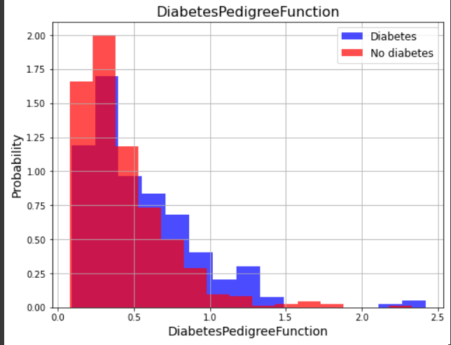
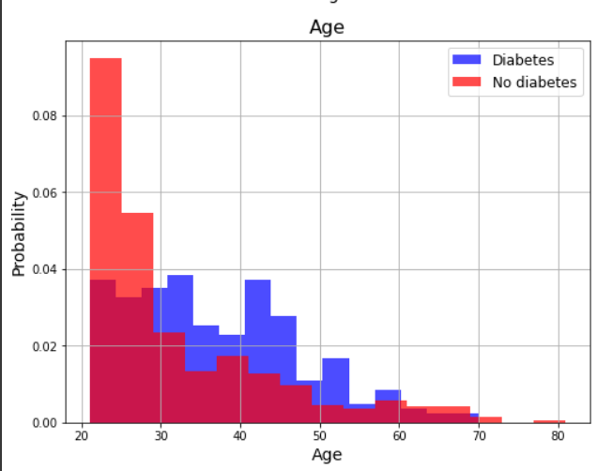
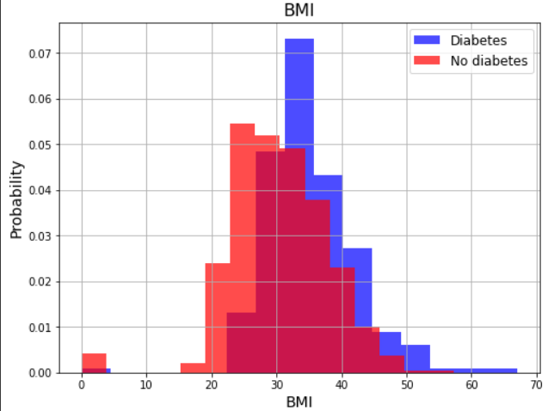
Data visualisation

Slide 9
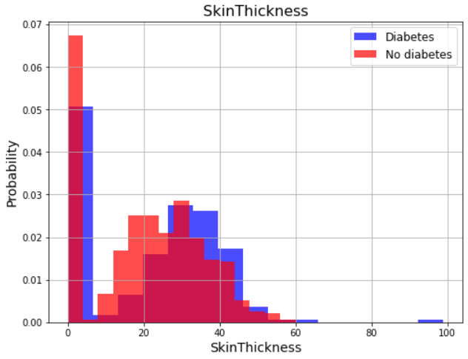
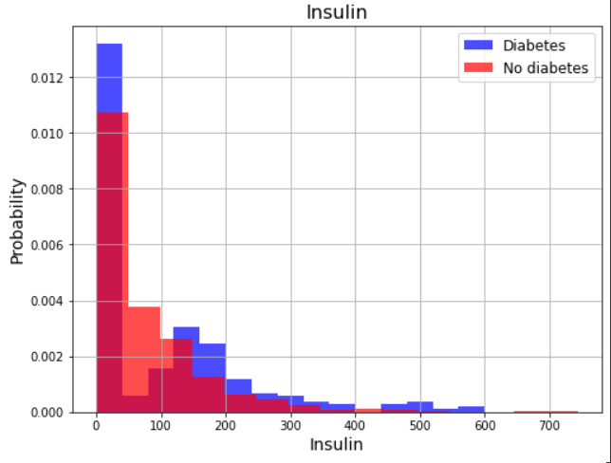
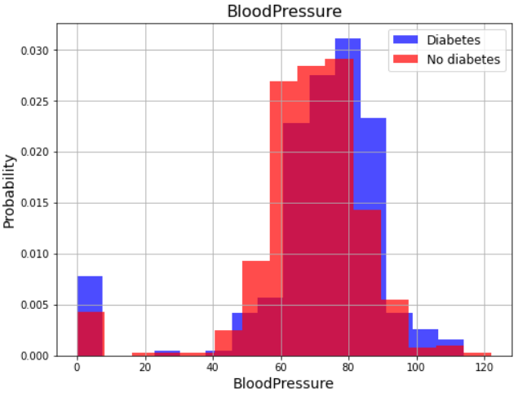
Data visualisation

Slide 10
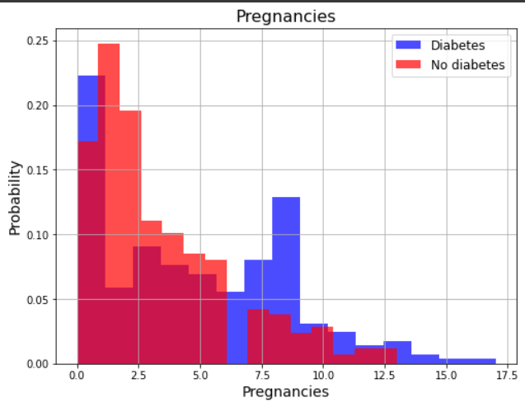
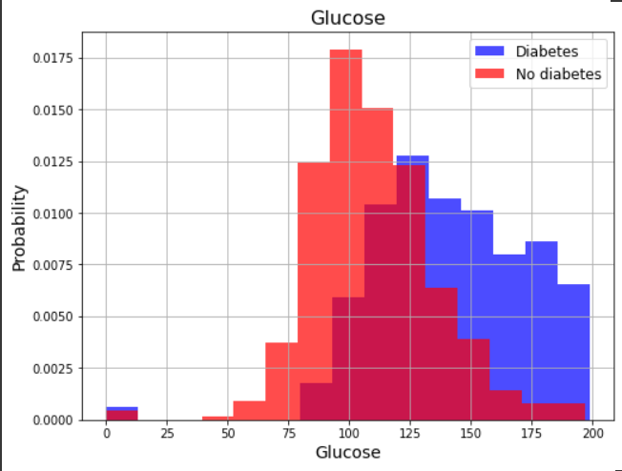
Data visualisation

Slide 11
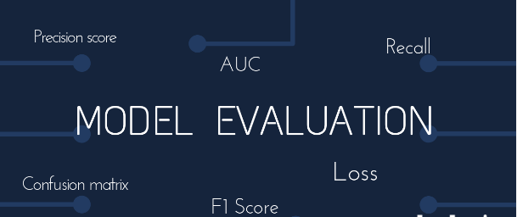
Model Evaluation
Evaluating the models performance using metrics such as accuracy, precision and recall.
Interpreting the results and providing insights on the reasons for Classifying Text.

Slide 12
Conclusion
In conclusion, the text classification project using the diabetes dataset involved developing a machine learning model that could accurately predict whether a patient had diabetes or not based on their medical history.
The project involved various steps such as preprocessing the data, exploring the data, feature engineering, model selection, model training, and model evaluation.
The results showed that the machine learning model was effective in predicting the presence of diabetes based on the patient's medical history, and the performance of the model was comparable to or better than existing methods for diagnosing diabetes.
The project has the potential to improve the accuracy and efficiency of diabetes diagnosis and treatment, thereby improving patient outcomes and quality of life.

Slide 13


